Slide 1
Conservation of Energy

Slide 2
Energy Transformations
Many mechanical processes involve interchanges between KE, PE, and work.
Energy exists in some other forms: chemical energy, heat energy, radiant energy, etc.

Slide 3
Conservation of Energy
Energy cannot be created or destroyed.
It can only be changed from one form to another.
The above statement is called the law of conservation of energy

Slide 4
Conservation of Energy
The total amount of energy possessed by an object is equal to the objects potential energy plus its kinetic energy
E_{T} = E_{P} + E_{K}

Slide 5
Energy Conservation
First Law: Energy can be converted from one form to another
Second Law: High quality energy sources can be effectively (almost 100%) converted to low quality energy sources. The reverse is not true – eg. Electrical to heat
Key to conservation: matching the quality of energy to the task to be performed

Slide 6
Conservation of Energy
When an object has been raised to a new height and is held there, its total energy can be represented as 100% potential energy since there is no movement.
If that object is released and allowed to fall, the instant before contact with the ground, the total energy of the object can be represented by 100% kinetic energy since all of the potential energy has been converted.

Slide 7
Conservation of Energy
Half way between the top and impact, the total energy of the object can be represented as follows: 50% as kinetic energy and 50% as potential energy
To calculate potential energy, use
E_{p}= mgh

Slide 8
Conservation of Energy
To calculate kinetic energy, follow these two steps.
A) using a known d, v₂² = v₁² + 2ad
Therefore v = √2ad
B) use this v in E_{k} = mv² / 2

Slide 9
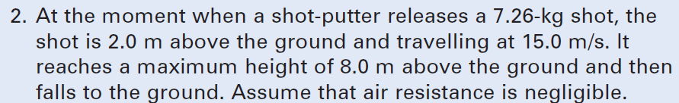
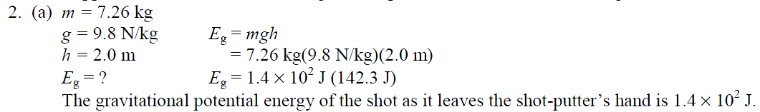
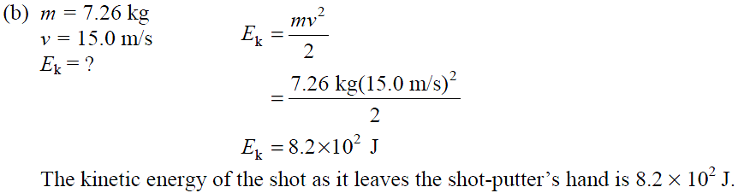

Slide 10
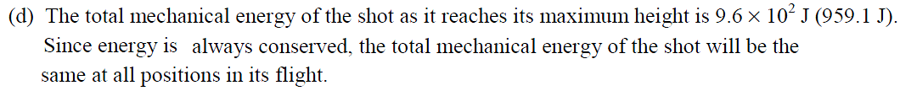
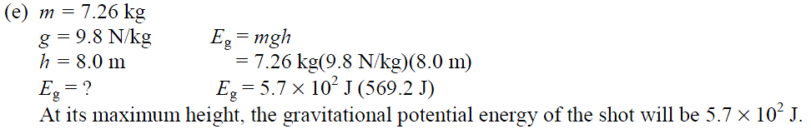

Slide 11
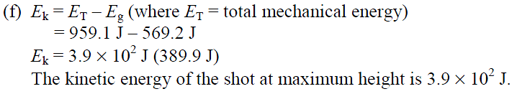
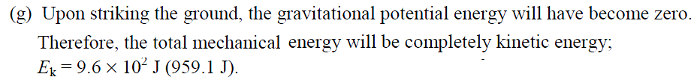
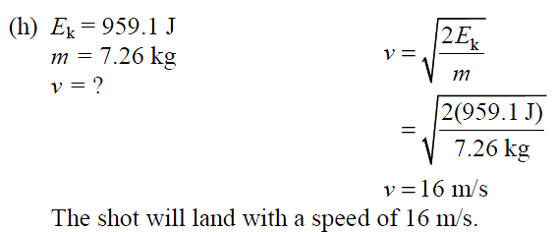

Slide 12
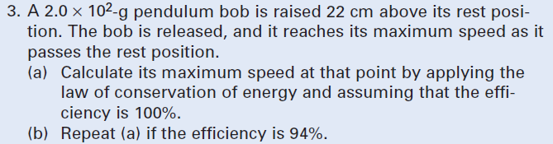
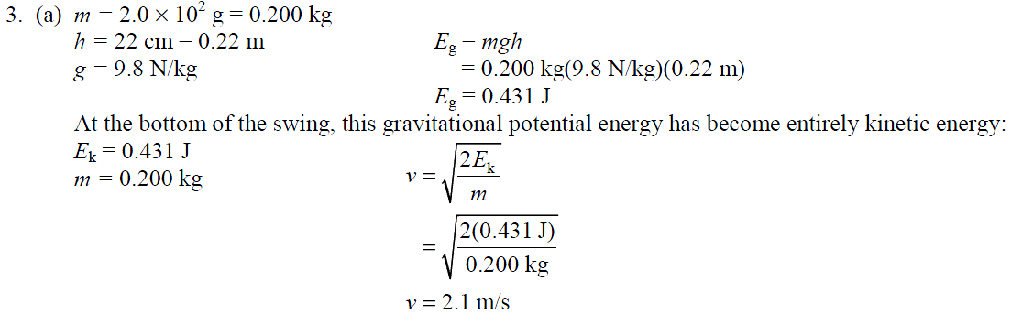

Slide 13
